Slide 1

Data Science Workshop: Crypto Arbitrage oracle
Presentation 2
Oz Cabiri
Guy Harem

Slide 2
crypto arbitrage
Problem: Cryptocurrency prices can vary across exchanges, creating opportunities for arbitrage, where traders exploit price differences to make a profit
Motivation: Exploiting arbitrage opportunities can maximize profits across different exchanges
Question: Can machine learning algorithms accurately identify arbitrage opportunities between multiple cryptocurrency exchanges using real-time price and volume data?
Goal: Develop a ML model to identify arbitrage opportunities in real-time between cryptocurrency exchanges

Slide 3
PROJECT OVERVIEW & DATA PIPELINE
Segment 1: Data collection
Segment 2: Feature engineering
Multiple features addition
Deep analyzation and preparation for ML
Data plotting
Data cleaning
Segment 3: ML model
Complex ML model able to make smart decisions on old/real-time data
Gather raw crypto data from real world exchanges

Slide 4
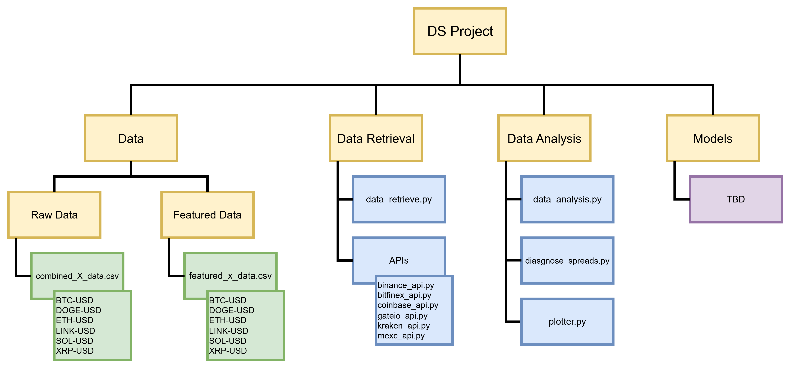
PROJECT STRUCTURE

Slide 5
SEGMENT 1: RAW DATA COLLECTION

Slide 6
SEGMENT 1: RAW DATA COLLECTION
6 Major cryptocurrency exchanges
Binance, Coinbase, Kraken, Bitfinex, Gate.io, MEXC
6 Cryptocurrencies
BTC, ETH, DOGE, LINK, SOL, XRP
Data Granularity
1- minute candles (OHLCV)
Planning for a week of Data (10,087 data points per crypto)
* Triangular data is treated different (A->B->C->A)

Slide 7
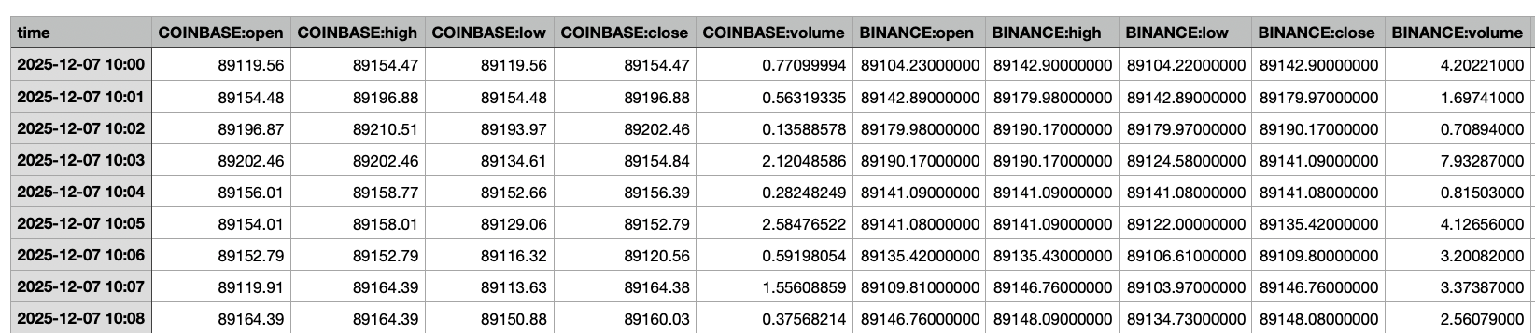
SEGMENT 1: API architecture
Data Structure
Time-synchornzied across exchanges (converted to UTC)
Structured CSV format

Slide 8
SEGMENT 1: challenges
Temporal misalignment
Not all exchanges have data for the same timestamps
Some exchanges missing certain cryptocurrencies
Data gaps could effect analysis quality
API rate limits
Exchange-specifc request limits
Required throttling and retry logics
Data quality issues
Missing values (NaN handling \ volume 0)
Volume discrepancies across exchanges

Slide 9
SEGMENT 2: FEATUTE ENGINEREEING

Slide 10
SEGMENT 2: FEATUrE ENGINEREEING
“From Raw Data to Predictive Features”
Raw Data limitations
Only shows what happened
Doesn’t show relationships between exchanges
Misses temporal patterns and trends
Feature engineering reveals much more
Arbitrage opportunists – price differences across exchanges
Liquidity constraints – Can we actually execute?
Market patterns – When and where opportunities occur
Risk indicators – How volatile is the opportunity?
Predictive signals – what might happen next?
Raw Data (~30 columns) -> 4 layers F.E Pyramid -> Featured Data (~153 columns)
Features added to featured_data CSVs (float, string, enum)
Stand-alone args plotter (WIP)

Slide 11
SEGMENT 2: Feature categories
Close spread
Price differences
Volume
Liquidity analysis
High-Low spread
Volatility ranges (Theoretical)
Time features
Temporal patterns
Volatility
Risk metrics
Price changes
Momentum indicators
Moving averages
Trend analysis
Bollinger averages
Statistical boundaries
Rolling statistics
Dynamic metrics
Rate of change
Acceleration features

Slide 12
SEGMENT 2: Feature architecture
# Layer 1: Raw Data
BINANCE:close = 95000
GATEIO:close = 95650
BINANCE:volume = 120
GATEIO:volume = 85
↓ (Layer 2 calculations)
# Layer 2: Derived Features
spread_close_pct = 0.68% # (95650-95000)/95000
buy_exchange = "BINANCE"
sell_exchange = "GATEIO"
min_volume = 85 # min(120, 85)
is_real_opportunity = 1 # (0.68% >= 0.6%)
↓ (Layer 3 calculations)
# Layer 3: Trend Indicators
spread_ma_15 = 0.45% # 15-min average spread
spread_ema_30 = 0.52% # 30-min exponential average
spread_bb_upper_15 = 0.75% # Upper Bollinger Band
↓ (Layer 4 predictions)
# Layer 4: Predictive Signals
spread_rate_change = +0.15% # Spread increasing
spread_zscore_30 = 1.8 # Above average (high)
opportunities_in_last_30 = 8 # Recent activity high
↓ (Final Decision)
ML MODEL PREDICTION:
✅ EXECUTE TRADE
- Spread above threshold, sufficient volume
- Spread trending up, - Recent high activity period
Layer 4: PREDICTIVE SIGNALS (spread_rate_acceleration, spread_zscore_30. etc)
Layer 2: DERIVED FEATURES (spread_close_pct, volatility_avg, etc.)
Layer 1: RAW DATA (BINANCE:close, KRAKEN:volume, time, etc. )
Layer 3: TREND & STATISTICAL INDICATORS (spread_ma_15, spread_rolling_std_10, etc. )

Slide 13
SEGMENT 2: current insights
Volume & liquidity
Low spreads != executable trades (absolute value)
Need sufficient liquidity on both sides (one tactic: hold crypto and funds in each exchange)
Only ~40% of opportunities have sufficient. voulme
Time-relevancy
Weekend opportunities rate: ~2-3% higher
Peak hours: 19:00-21:00 UTC (US-Asia overlap)
Day patterns vary by cryptocurrency
Statistical analysis
Most common buy: Binance, Coinbase
Most common sell: Gate.io, MEXC
Top pair: Coinbase -> Gate.io
Average opportunity lasts for 3-5 minutes

Slide 14
SEGMENT 2: Challenges
Our biggest limit – Trading costs
Trading costs eat ~50% of apparent profit
New tactic to observe: transfer-sell strategy (more profitable in transactions above 1/3 BTC= 33k$)
Performance issues (computational cost)
Feature interdependencies (Order matters)
Temporal features need sufficient history (5,15,30)
Volume limitations reduce executable opportunities
Speed is critical
Automated trading
In-hold cash and crypto
Trading costs table
Cost componenet | Percentage | Notes
Trading fees | 0.15%*2 = 0.30% | Volume based discounts
Transfer fees | 0.05% | Withdraw/Deposit
Time risk | 0.05%
Slippage (Saftey) | 0.10%
Profitabily margin | 0.10% | 100$ profit on 100k$
Total | 0.60% | Realistic

Slide 15
SEGMENT 3: ML MODEL

Slide 16
SEGMENT 3: ML MODEL (FUTURE WORK)
What we want to achieve
Opportunity Prediction
Time-to-Opportunity forecasting
Duration Estimation
How long opportunity lasts?
Execution window optimization (choose between tactics)
Profitability Classification
Account for slippage
Volume constraints
Risk-adjusted returns
Probability scoring

Slide 17
SEGMENT 3: Proposed ml architecture
Time series Forecasting
LSTM/GRU for spread prediction
Classification
Random Forest / XGBoost
Evaluation Metrics
Combine prediction + classification
Ensemble Approach
Precision (avoid false positives)
Input: Past 30 minutes of features
Output: Next 5-10 minutes spreads
Binary: will profitable opportunity occur in next N minutes?
Features: All 153 engineered features
Recall (catch real opportunities
ROI simulation
Confidence scoring system
Cypto Arbitrage Model

Slide 18
WHAT’s next?

Slide 19
WORKPLAN
Get datasets with API✅
Adjust database structure and units to be uniform✅
Combine datasets✅
Clean outliers, irrelevant data and problematic entries ✅
Data engineering: identify feature importance ✅
Fine-tune ML algorithms to detect arbitrage opportunities
Apply model on real-time data

Slide 20
Milestones
Retrieve relevant datasets using APIs + merge datasets (P1)
Data engineering: decide on features, identify setbacks and consider possible solutions (P2)
Workable model on existing data (P3)
Deploy model on real-time data + derive conclusions on model’s accuracy and viability (final)

Slide 21
Next steps (FOR FINAL PRESENTATION)
Immediate
Collect more historical data (weeks/months)
Implement basic ML model
Back test strategies
Future Development (product?)
Real-time data pipeline
Live deployment with paper trading
Automated trading bot
Risk management system
Multi-crypto portfolio optimization
Performance monitoring dashboard
Long-term goal – fully automated system

Slide 22
Questions?

